Slide 1
Last Week
This Week
2D Power Splitter
2D Power Splitter

Slide 2

2D Power Splitter – Algorithm
Without Nerual Network
ARLA (Additive Reinforcement Learning Algorithm)
Training
Data
Result
Structure
Algorithm
With Neural Network
FCDNN (Fully Connected Deep Neural Network)
ResNet (Residual Network)
DenseNet (Dense Network)
$$f\left(x\right)=g\left(x\right)+n(x)$$
FDTD
Simulation
Neural
Network
error
Initial
structure
Neural
Network
Result
Structure
Optimizer
Iteration

Slide 3
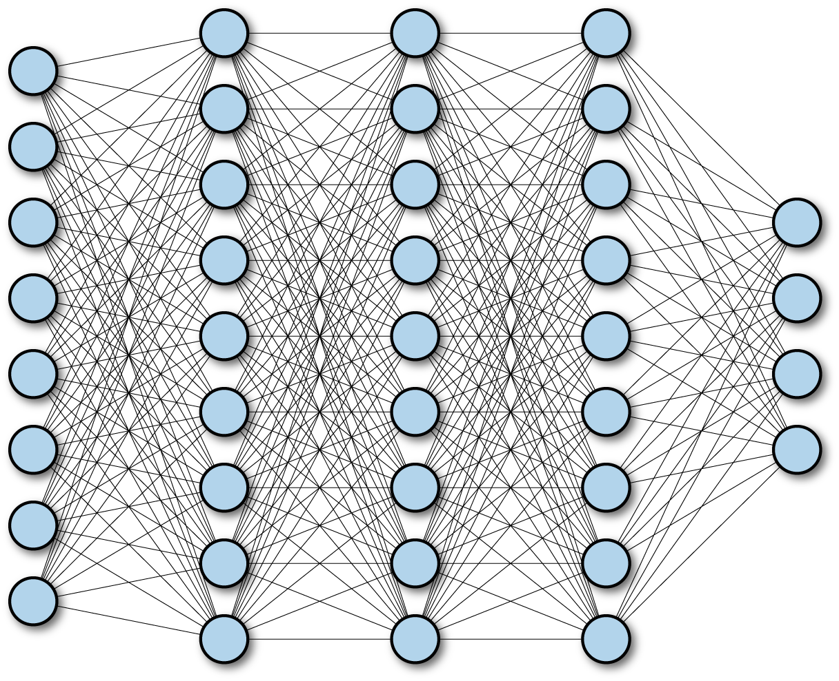
2D Power Splitter – Algorithm
FCDNN (Fully Connected Deep Neural Network)
Input
Output
ResNet (Residual Network)
Layer
1
Layer
2
Layer
3
Layer
4
Input
+
+
Output
DenseNet
Dense Block
Layer
1
Layer
2
Layer
3
Layer
4
Input
+
+
+
+
Output

Slide 4
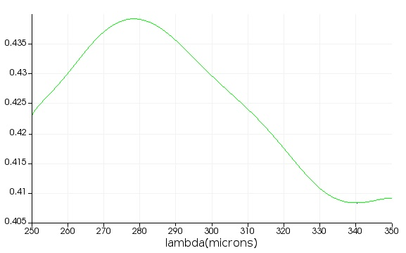
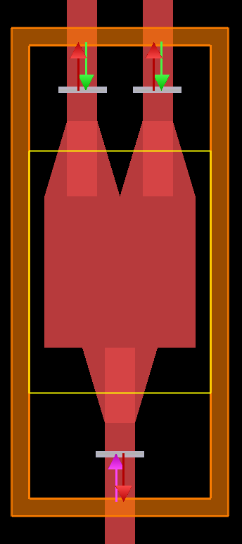
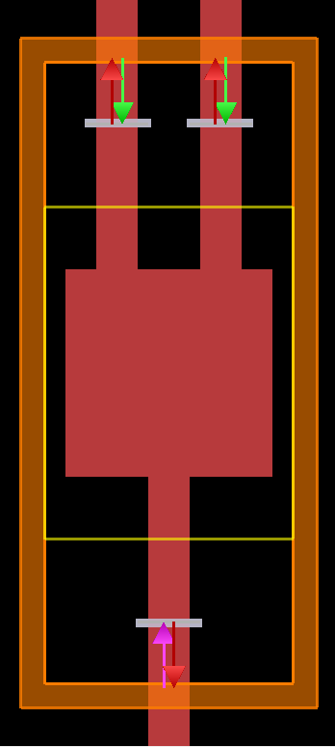
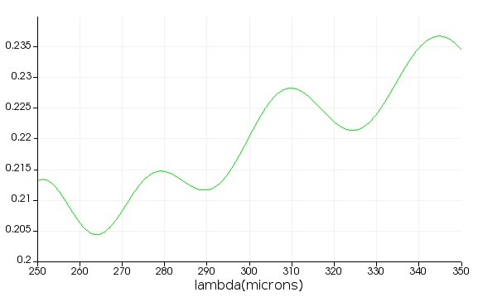
2D Power Splitter – FDTD Setting
Output 1&2
(b)-1
(a)-1
(a)-2
~ 0.4
(b)-2
~ 0.2
Simulation region: 250 ~ 350 um
Waveguide thickness: 100 um
Square: 500 um x 500 um
Taper connection: 250 um
Holes: 20x20 with a radius of 9 um

